Slide 1
Angular for Rank Beginners
Nick Hodges
nick@nickhodges.com
http://anglesandtypes.io
@nickhodges

Slide 2
About Me
Former Naval Intelligence Officer
Software Development Manger at Gateway Ticketing Systems
We are hiring!
Long-time Delphi Developer, Former Delphi Product Manager
Author of three Delphi books (Ask me about self-publishing….)
Extensive Conference Speaking Experience

Slide 3
Prerequisites
You have to know nothing about Angular beyond “it’s some kind of web framework….”

Slide 4
Agenda
Introduction
Installing and getting started
Using the CLI
Basic Application
Running Things
Conclusion/Questions

Slide 5

History of Angular Framework
Started out as AngularJS
20% Project at Google started by Miško Hevery and Adam Abrons
Completely re-written as Angular 2
Current version is 6.1
Backed by Google
https://angular.io/
https://www.madewithangular.com/

Slide 6
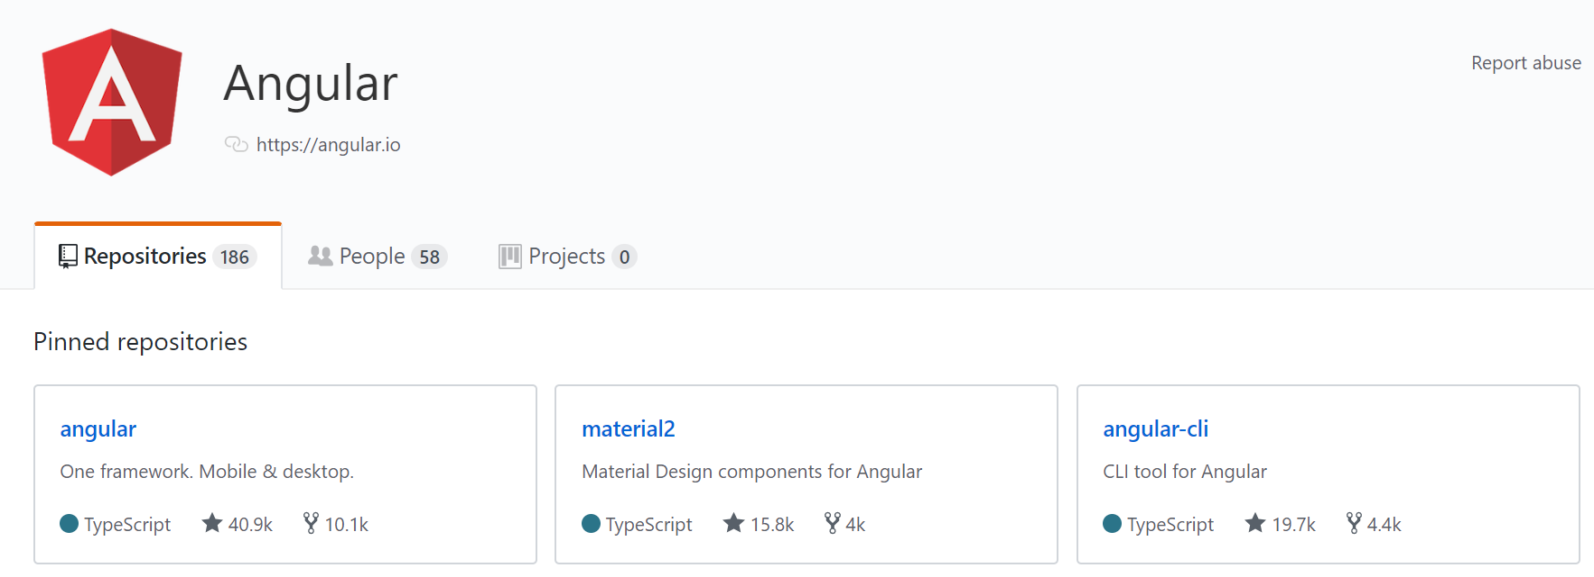
Why Angular?
Angular is opinionated
Angular is trustworthy
Angular is familiar
Angular is scalable
Angular has an eco-system
Angular is open source

Slide 7
Hello TypeScript
TypeScript is a JavaScript that adds classes (OOP)
All JavaScript is TypeScript
Transpiles (compiles) to JavaScript
Open source project run by Anders Hejlsberg and Microsoft
Hosted on (surprise!) GitHub
Purpose is to:
Make large scale JavaScript applications manageable and maintainable
Provide tooling and ease of development around code

Slide 8
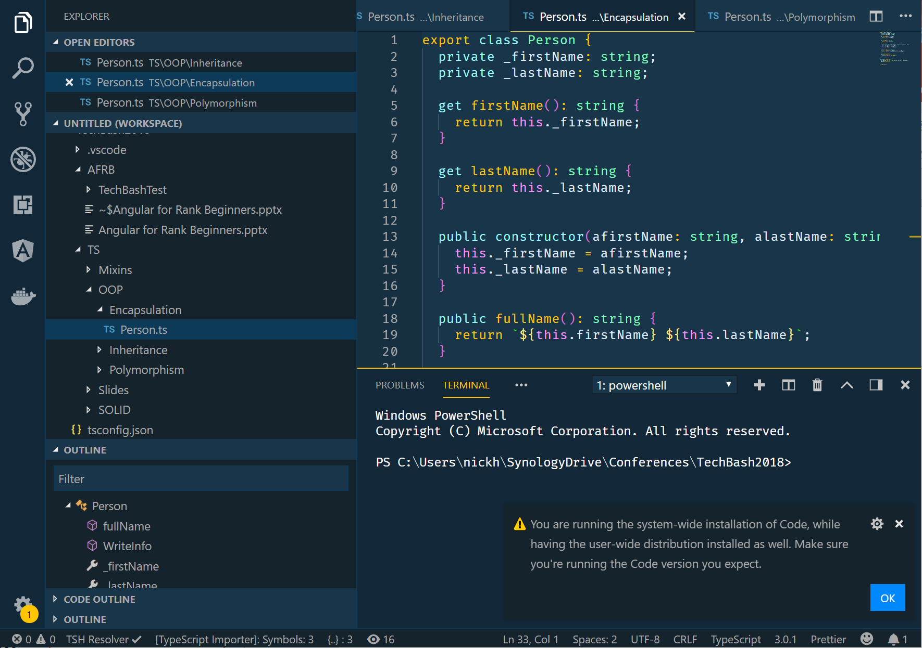
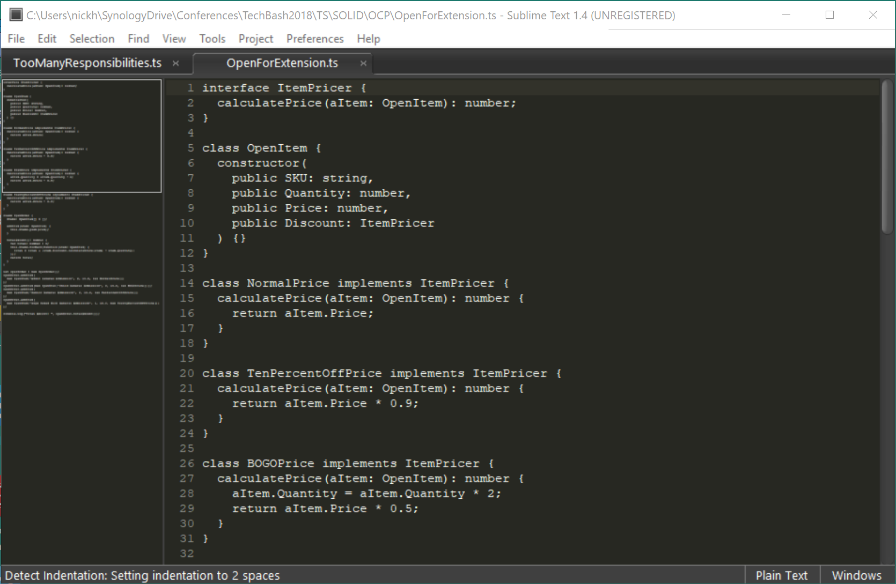
Getting Started
Choose an Editor
Strong Support for Angular Applications

Slide 9
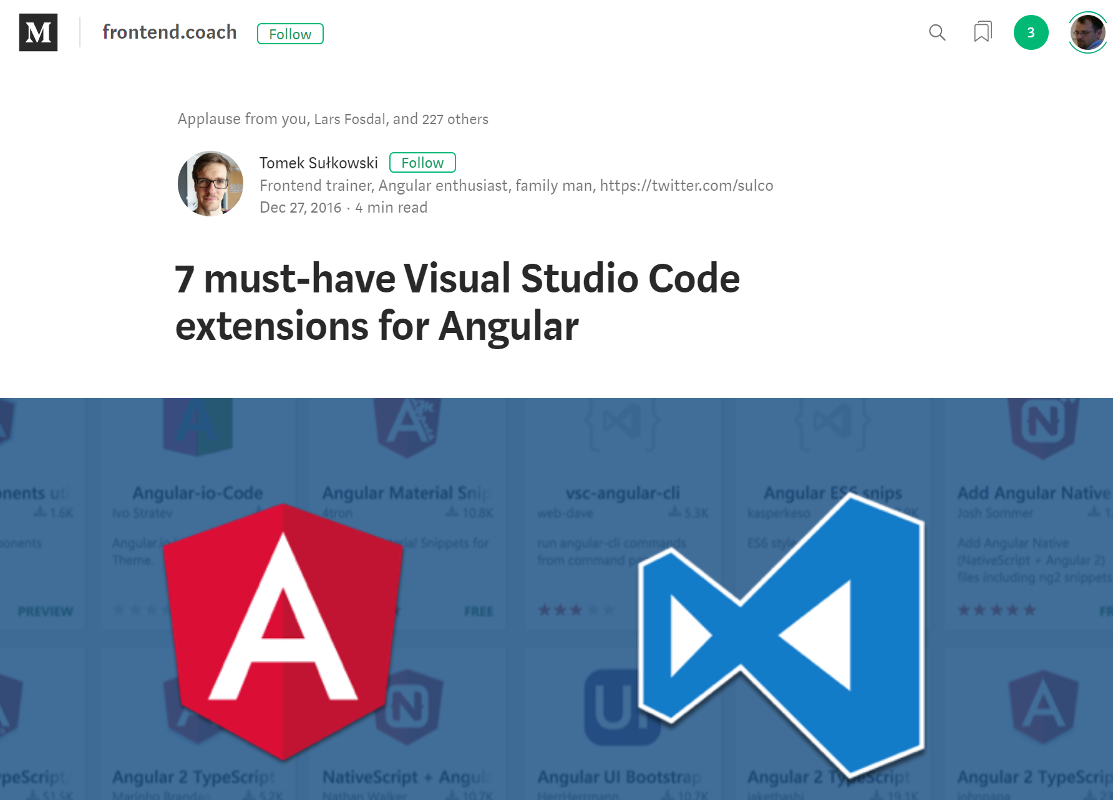
Angular Extensions for VS Code
http://bit.ly/NGExtensions

Slide 10

Install Node and NPM

Slide 11
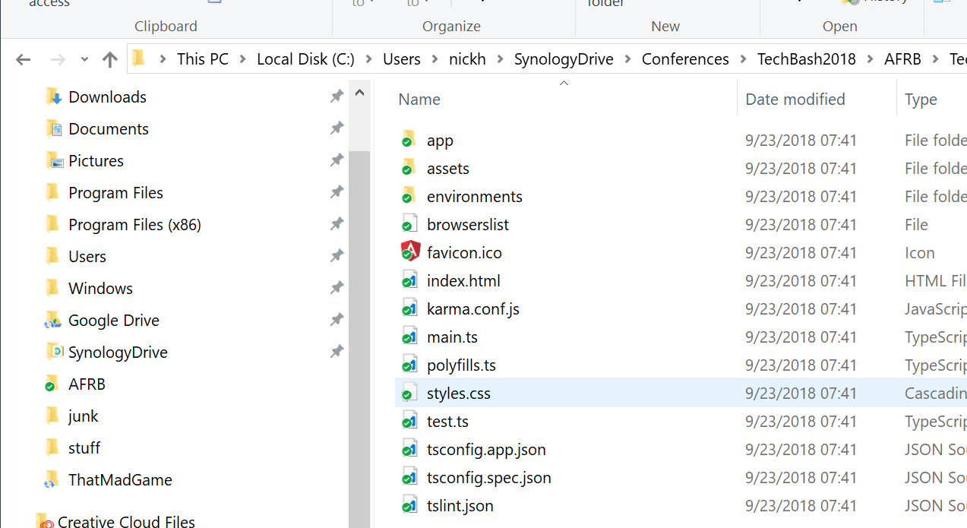
Install Angular CLI
npm install -g @angular/cli
Angular Command Line Interface
Good for starting and scaling applications

Slide 12
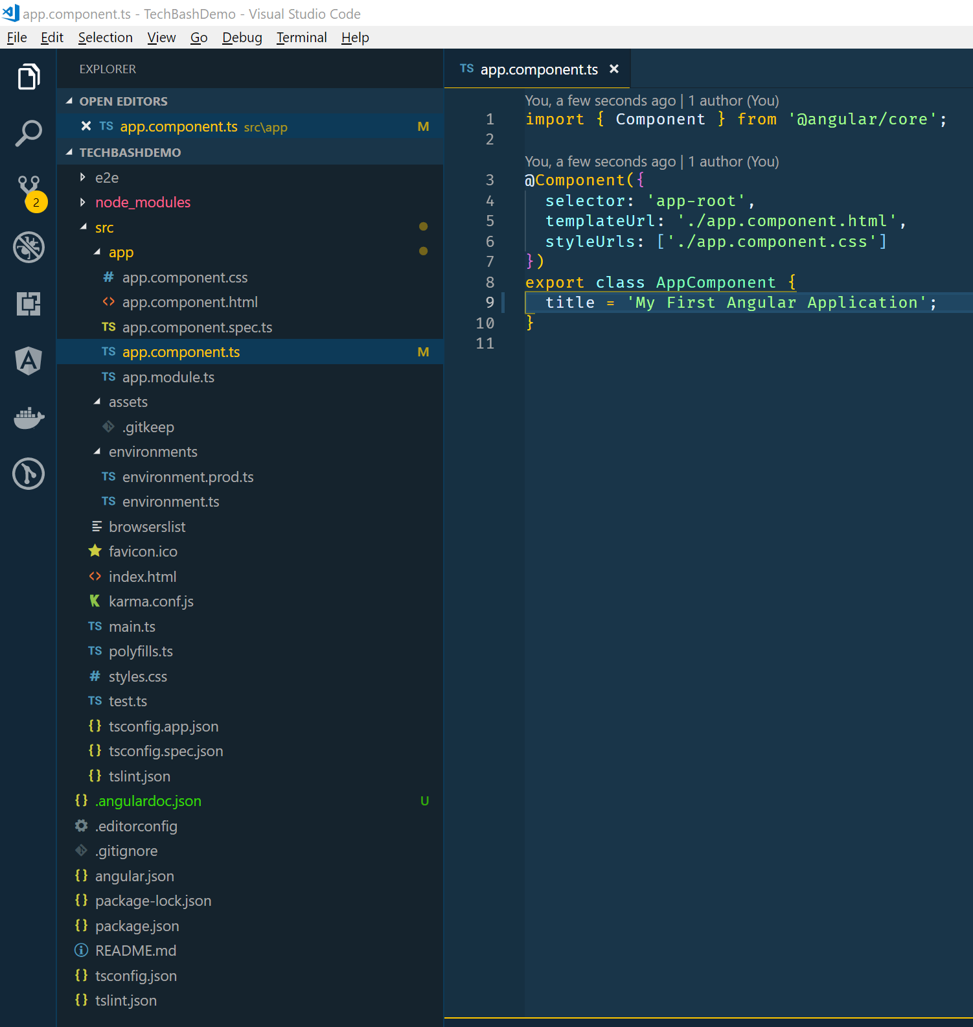
Anatomy of an Angular Application
TypeScript based
Single Page Applications (SPA)
Run Client-side
Apps are component based
Uses WebPack to serve applications
Cross-platform
PWA, Native, Desktop
Optimized compiling

Slide 13
Angular Parts
Modules: Provide structure to application
Components: Provide views into page
Templates: HTML-like tags to layout application
Metadata: Decorators to define how modules/components work
Data binding: Allow code and HTML to interact (two-way)
Directives: Manipulate the DOM with in-HTML code
Services: APIs to get data and other information
Dependency Injection: Automatically get fully formed classes/services

Slide 14
Let’s go to the code!

Slide 15
Resources
Main Page: http://angular.io
Official Docs: https://angular.io/docs
Project on Github: https://github.com/angular
My Blog: http://www.anglesandtypes.io
Best VS Code Plugins:
http://bit.ly/VSCAngular
http://bit.ly/NGExtensions

Slide 16
Questions
Nick Hodges
nick@nickhodges.com
http://anglesandtypes.io
@nickhodges

